Slide 1
PORTFOLIO
Top 10 Photos of
2023
Nola Patty Photography

Slide 2
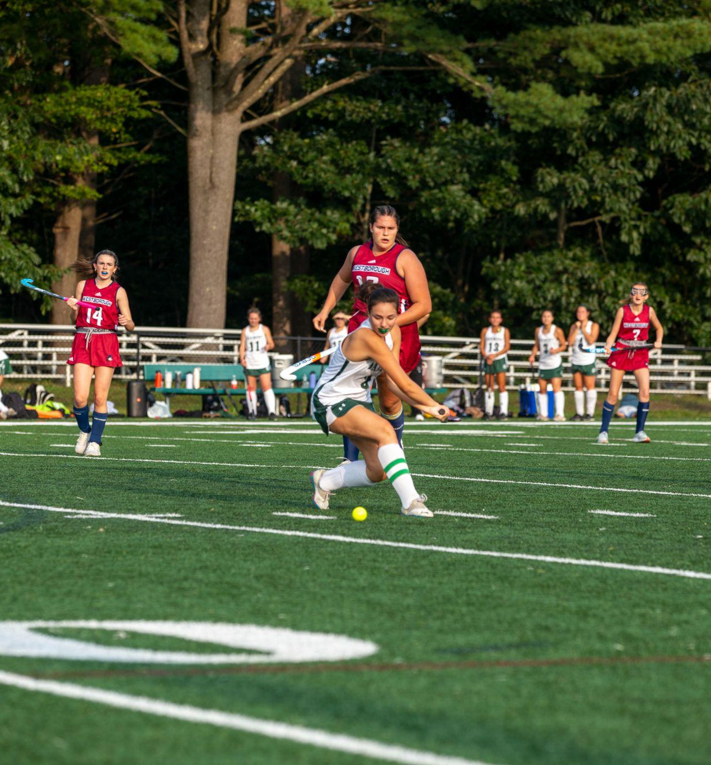
Field Hockey
10
This one is of Addie Collette reverse hitting the ball

Slide 3
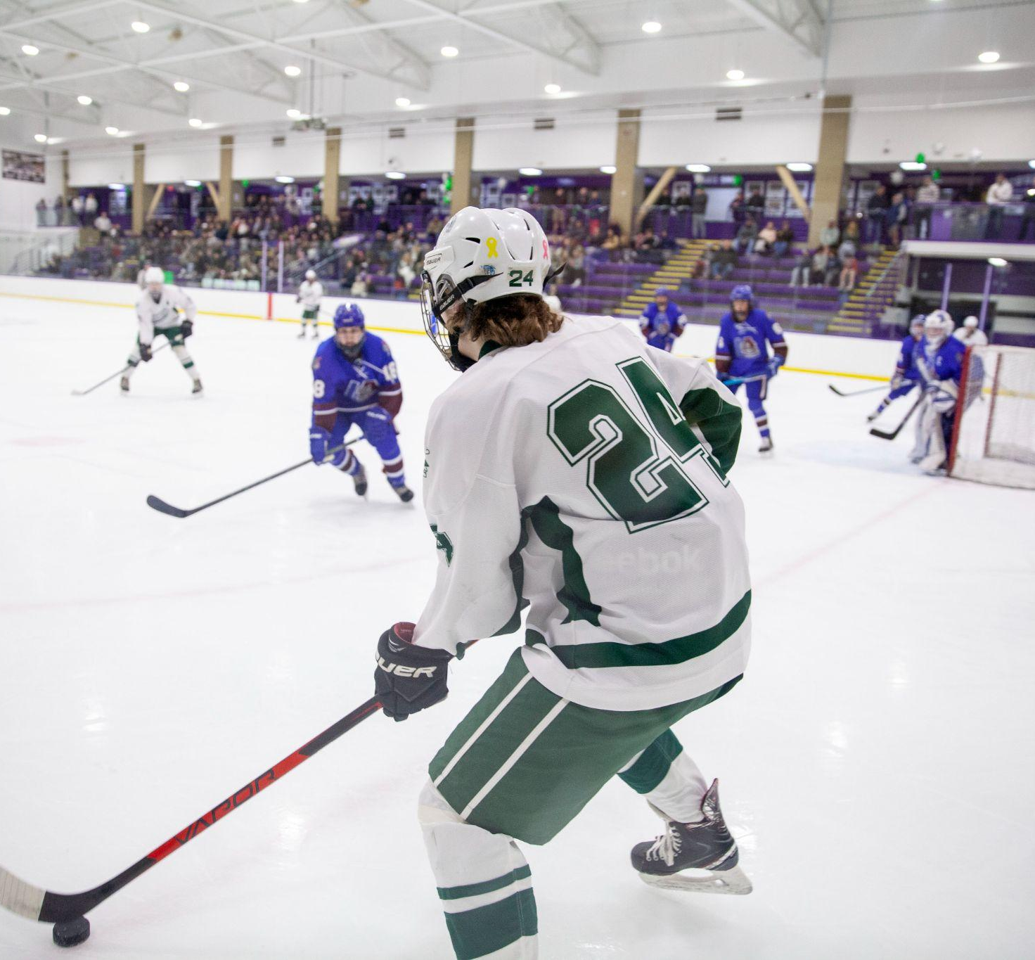
Ice Hockey
9
This is a wide angle shot, this was the first picture I took with my new lens

Slide 4
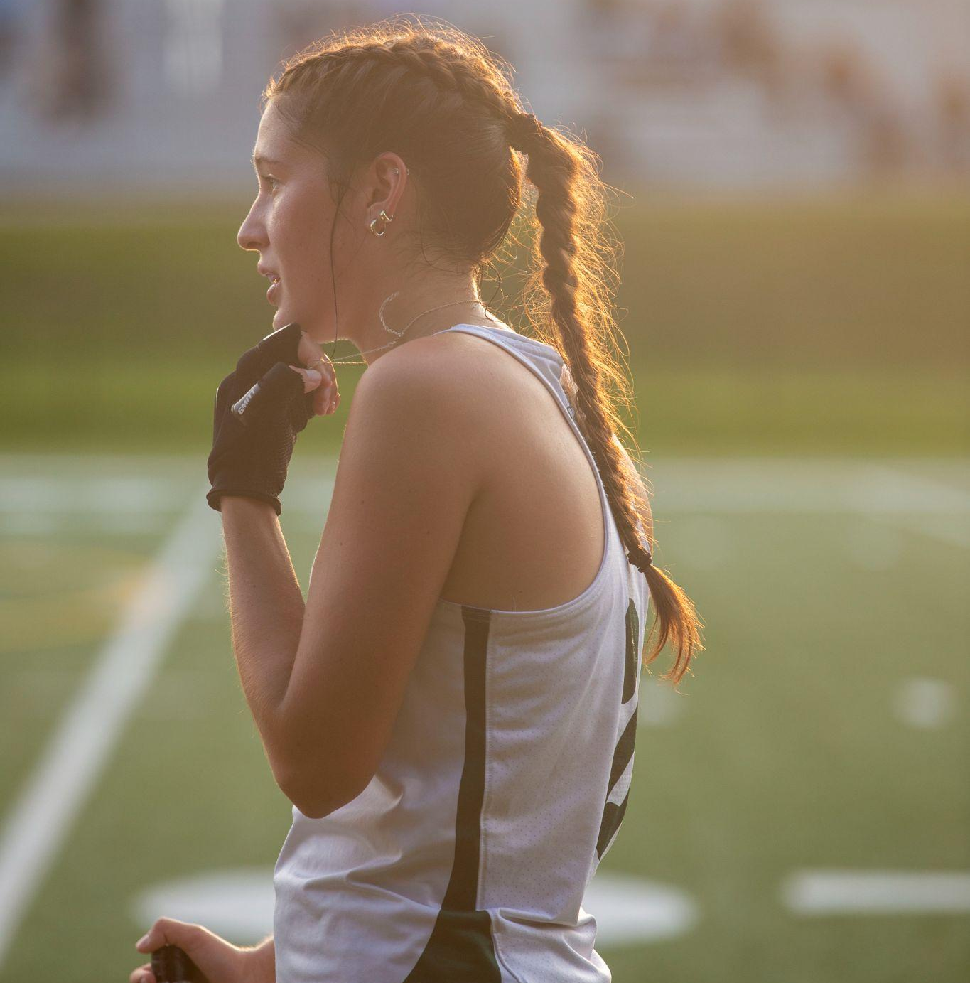
Field Hockey
8
I really liked the sun behind this photo it highlights Addi’s hair

Slide 5
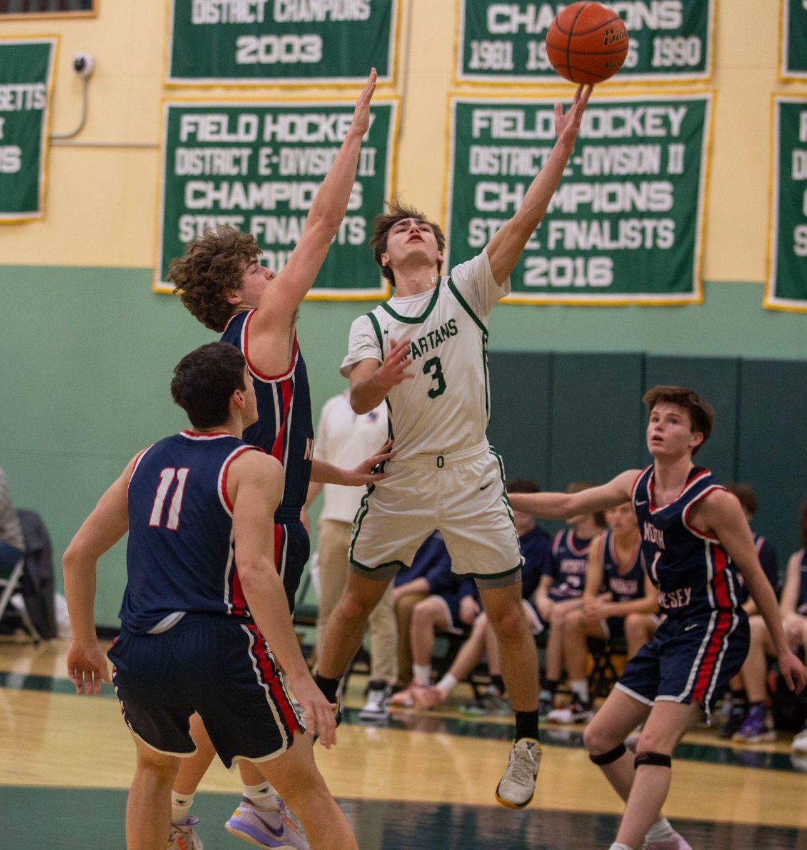
Basketball
7
This was a cool jump photo I got

Slide 6
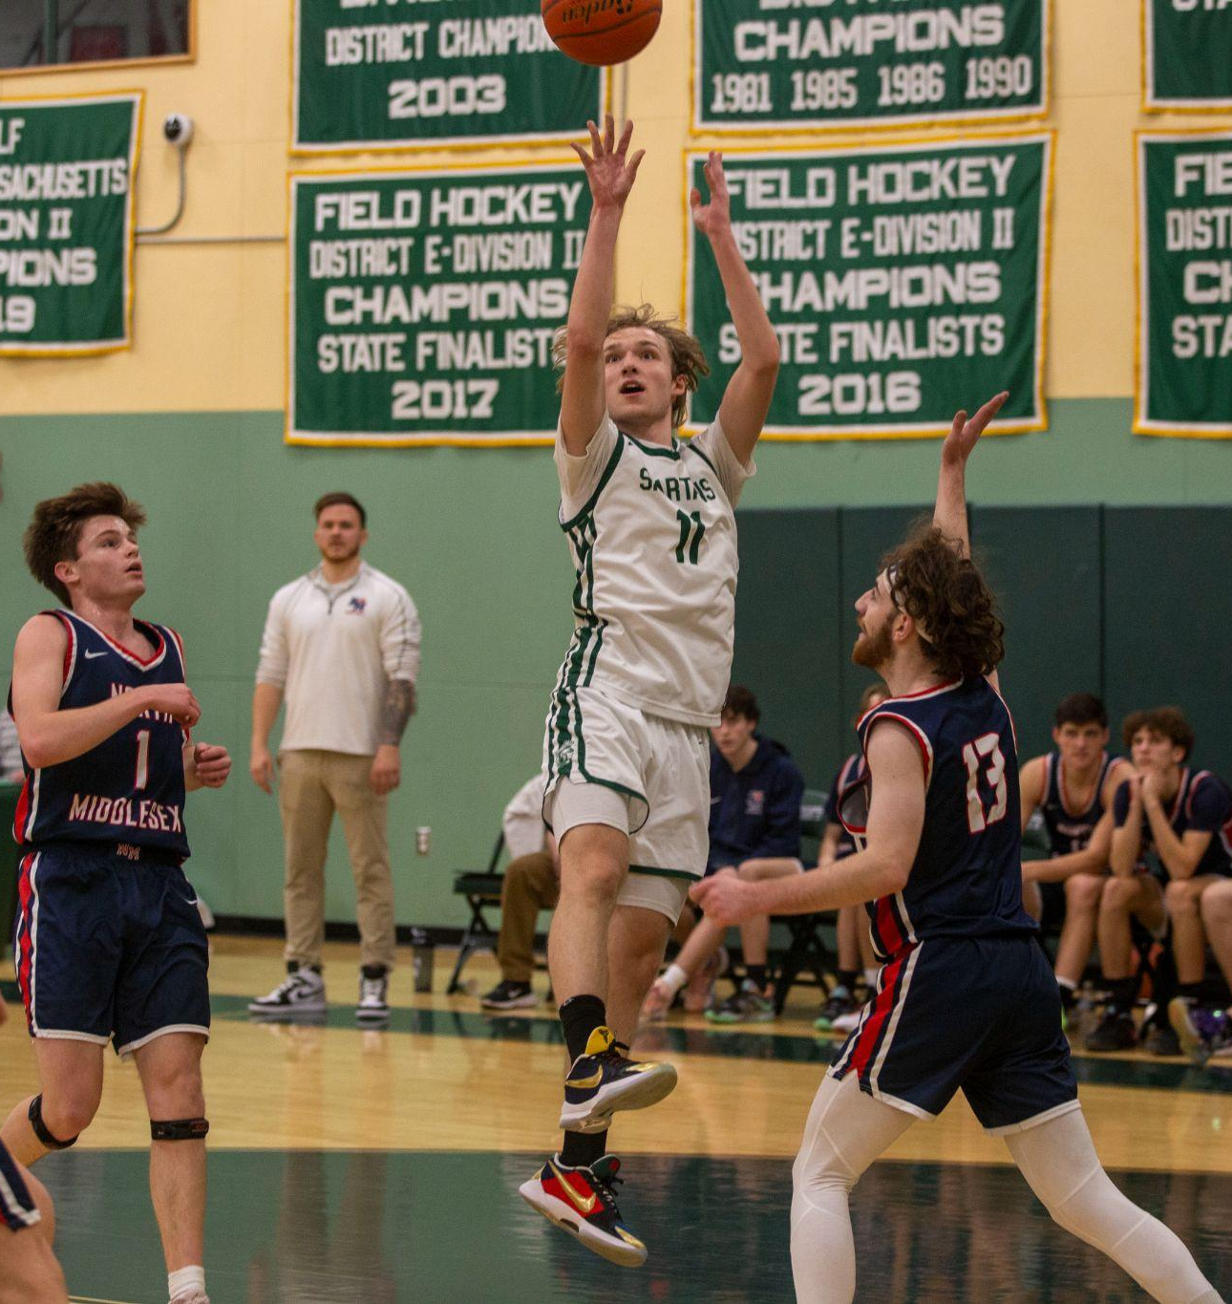
Basketball
6
This was tied for the last photo by Ryan scored 1000 points so he gets the #6 spot

Slide 7
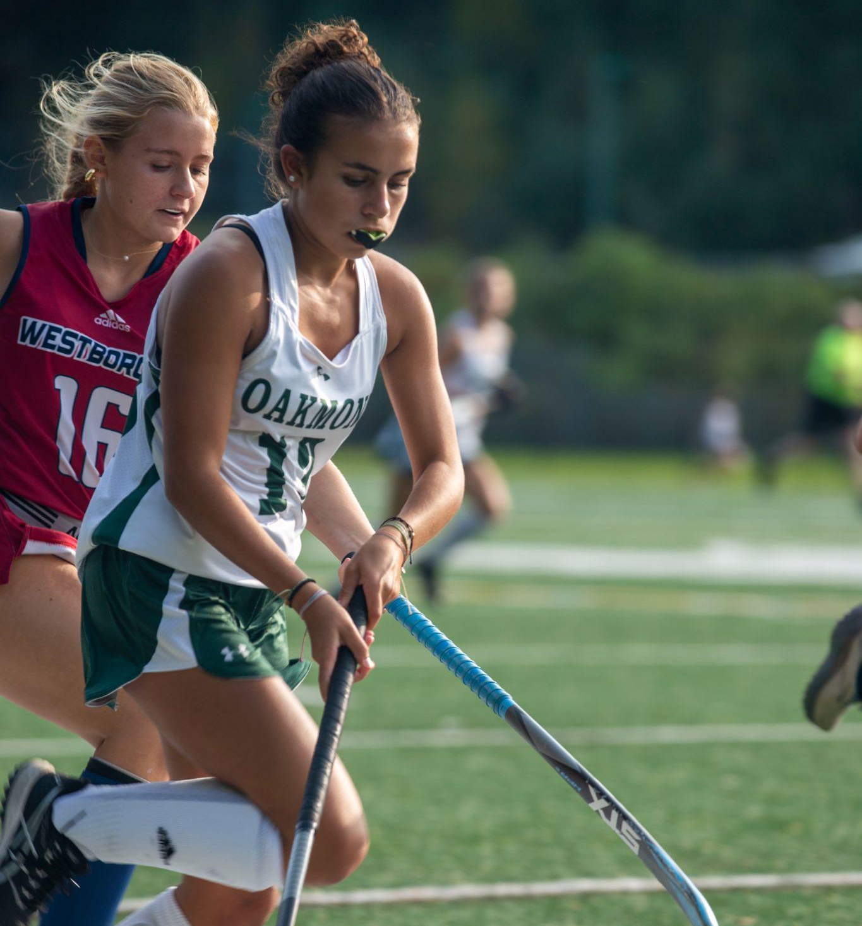
Field Hockey
5
I really like how close this shot is and how infocus it is

Slide 8
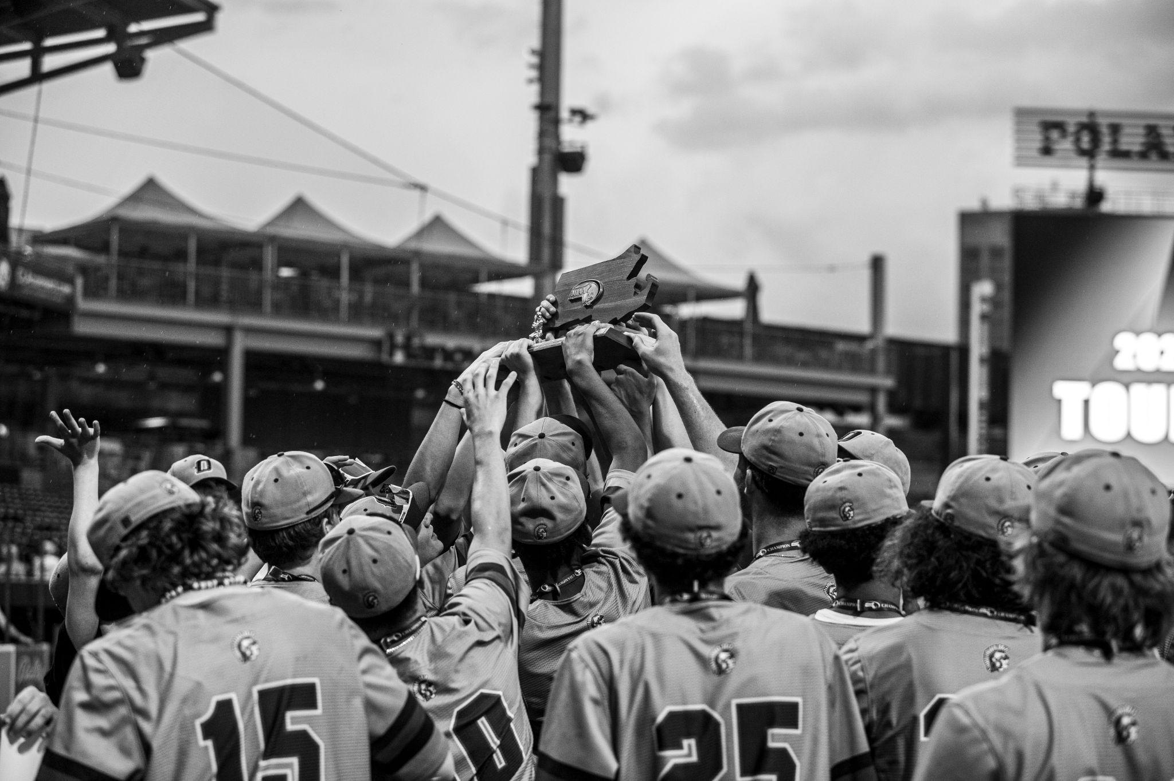
Baseball
4
I captioned this “ It takes many hands to move a mountain”

Slide 9
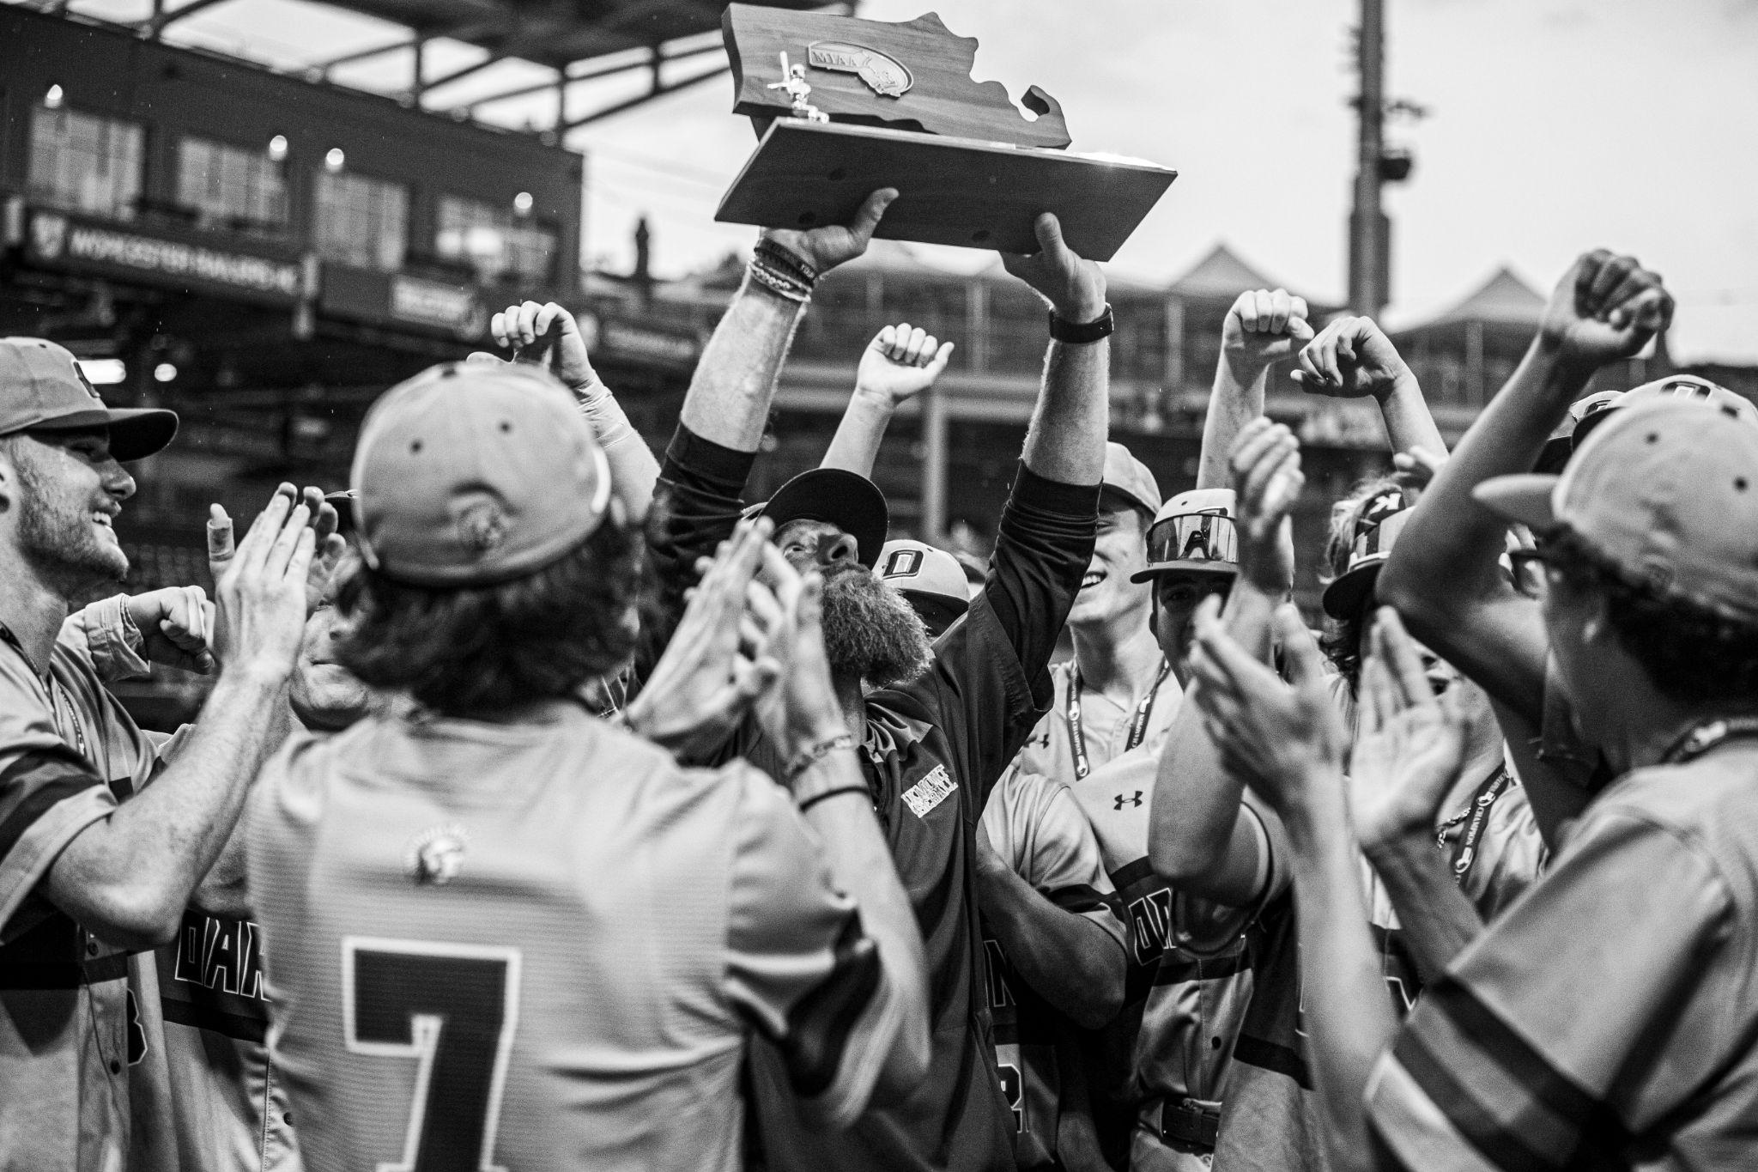
Baseball
3
I think this is a really special picture for Caouette

Slide 10
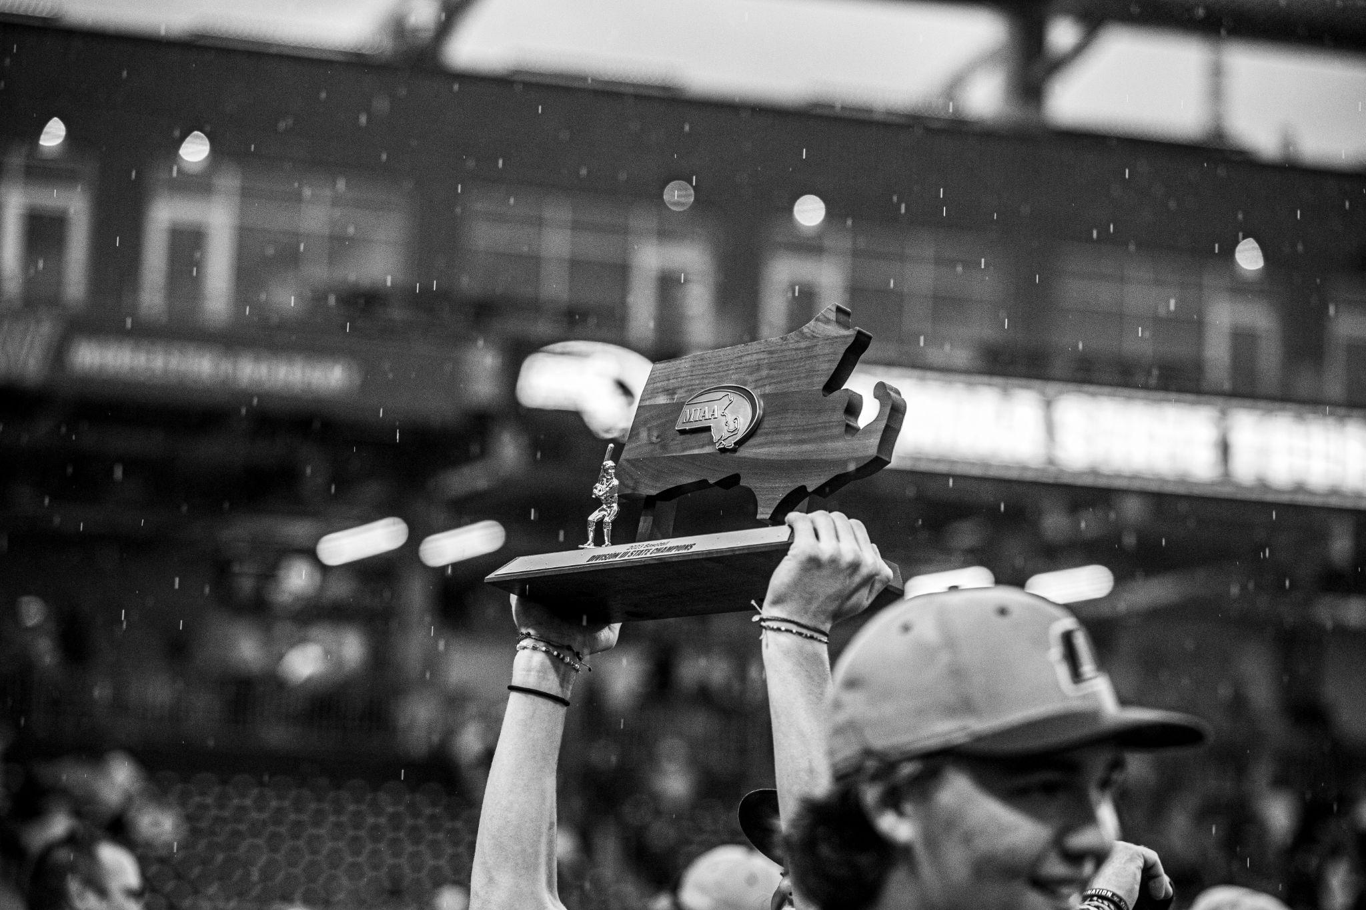
Baseball
2
I really like the rain in this photo

Slide 11
Now for #1…..

Slide 12
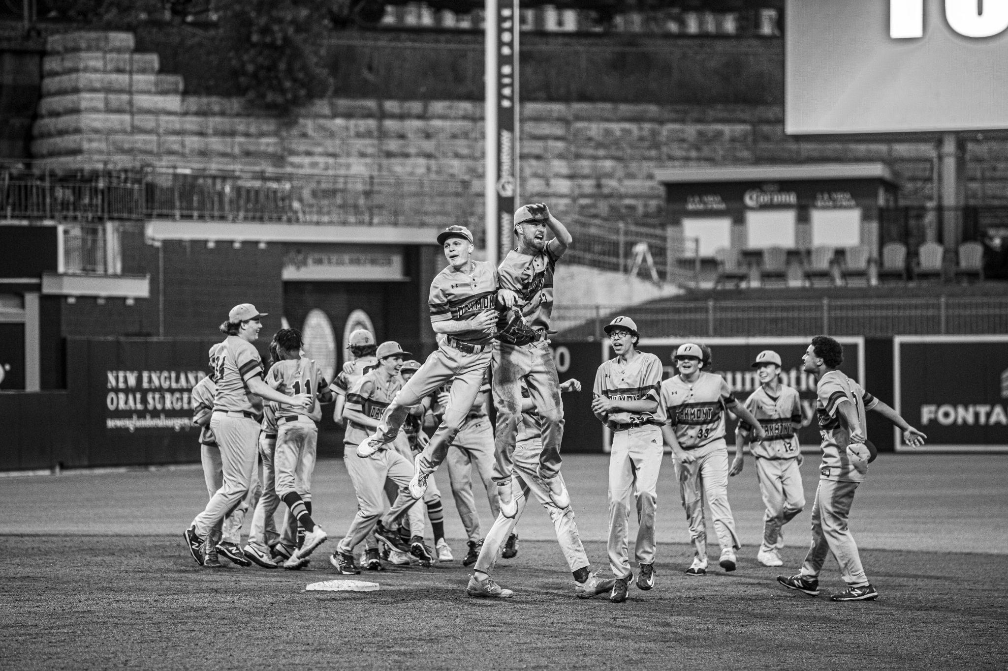
Baseball
1
The best photo I have ever taken

Slide 13
Go follow my instagram right now or i will delete all these photos

